Slide 1
Secured Programming with C
UE17CS257C
(2-0-0-0-2)
Dr. D.C.Kiran
Associate Professor
Department of Computer Science and Engineering

Slide 2
How To Write Project Report

Slide 3
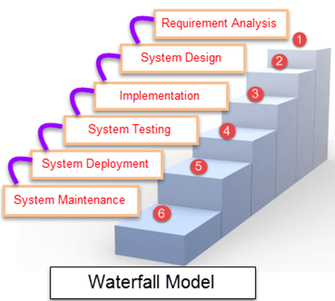
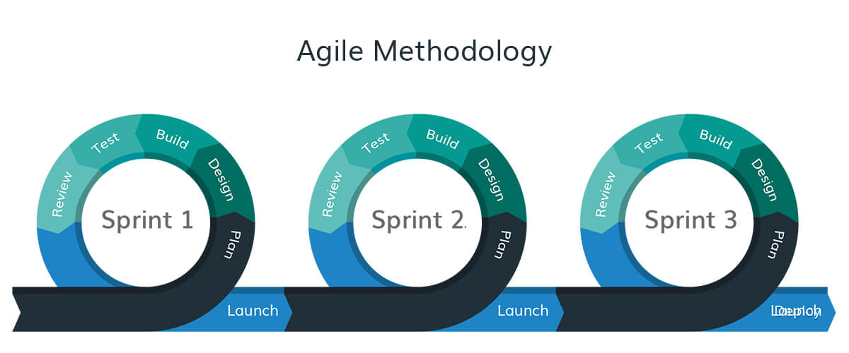
Software Development Life Cycle: SDLC

Slide 4
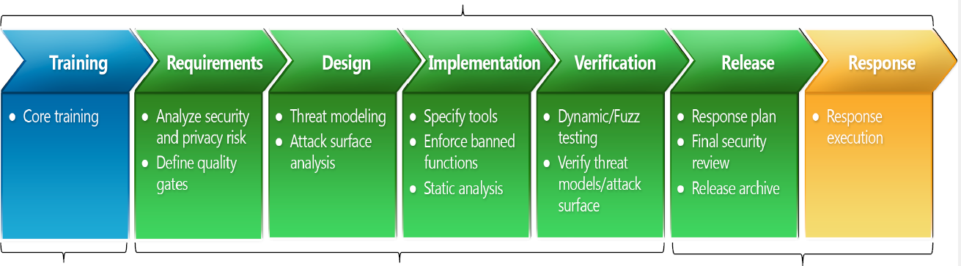

SDLC & SDL
Microsoft Secure Software Development Lifecycle

Slide 5
Doing the report.
I suggest the following plan for writing a report.
Identify the story you wish to tell. Often this can be simply done by deciding which diagrams and graphs of data you wish to include.
Draw up a plan of what you want to say and how this fits around the diagrams/graphs you want to use.
Extend you plan to an outline that includes all the section headings you will need.
Check through the outline to see that sequence is sensible and that nothing vital has been ignored.
Check your outline through with someone else e.g. fellow student, tutor or demonstrator.
Write a first full draft of the report.
Check the first draft through for consistency, obvious errors and omissions (e.g. figure captions missing? References still to do?) If you can get a friend to read through it critically so much the better.
Revise the draft and re-check until satisfied.
Submit report.

Slide 6
Layout
• Title
• Authors
• Abstract
• Table of contents
• Introduction
• Requirement Specification
• Implementation
• Results and discussion
• Summary/conclusions
• References
• Appendices (if used)

Slide 7
First Page: Title
This should convey the area and scope of the project.
For example, “Rainbows” is poor – is this an investigation of the occurrence of rainbows in medieval illuminated manuscripts? or their use as metaphors in popular art? Or what?
A better choice might be “Rainbows: the deflection of light by liquid droplets and the determination of droplet refractive index from measurements of rainbow phenomena”

Slide 8
Second Page : Abstract
The second page should consist only of the abstract. The idea of the abstract is to provide a brief summary of the report. The reader should be able to pick up from the abstract what the abstract entailed, how it was undertaken and an indication of what was found out. An abstract should not review the report, but should rather act as a sampler of the contents of the report. Typically the abstract should be less than 200 words.
A poor example of title and abstract might be,
“The length of a piece of wood.”
The length of the piece of wood was found to be shorter than it should have been. We had problems with our measuring device and could not obtain good results. With better equipment we could have got better results.
It is poor because,
The length of the piece of wood was found (how was it measured?) to be shorter (by how much?) than it should (should? – say’s who?) have been. We had problems (what sort of problems?) with our measuring device and could not obtain good (what is meant by good?) results. With better equipment we could have got better results (a cop out!).

Slide 9
Second Page : Abstract
A better title and abstract might be,
“Interferometric measurements of the length of a piece of wood and discrepancies with previous spectroscopic measurements”
The length of a piece of wood was measured using an interferometric technique. Our results gave a length shorter by 1.5% than that found by Hamel et al [1] who used a spectroscopic technique. However, our measurements suffered from a large random error (2%), which we attribute to the use of a lamp as the source of light. An alternative interferometric measurement strategy employing a laser is suggested that should overcome this problem.

Slide 10
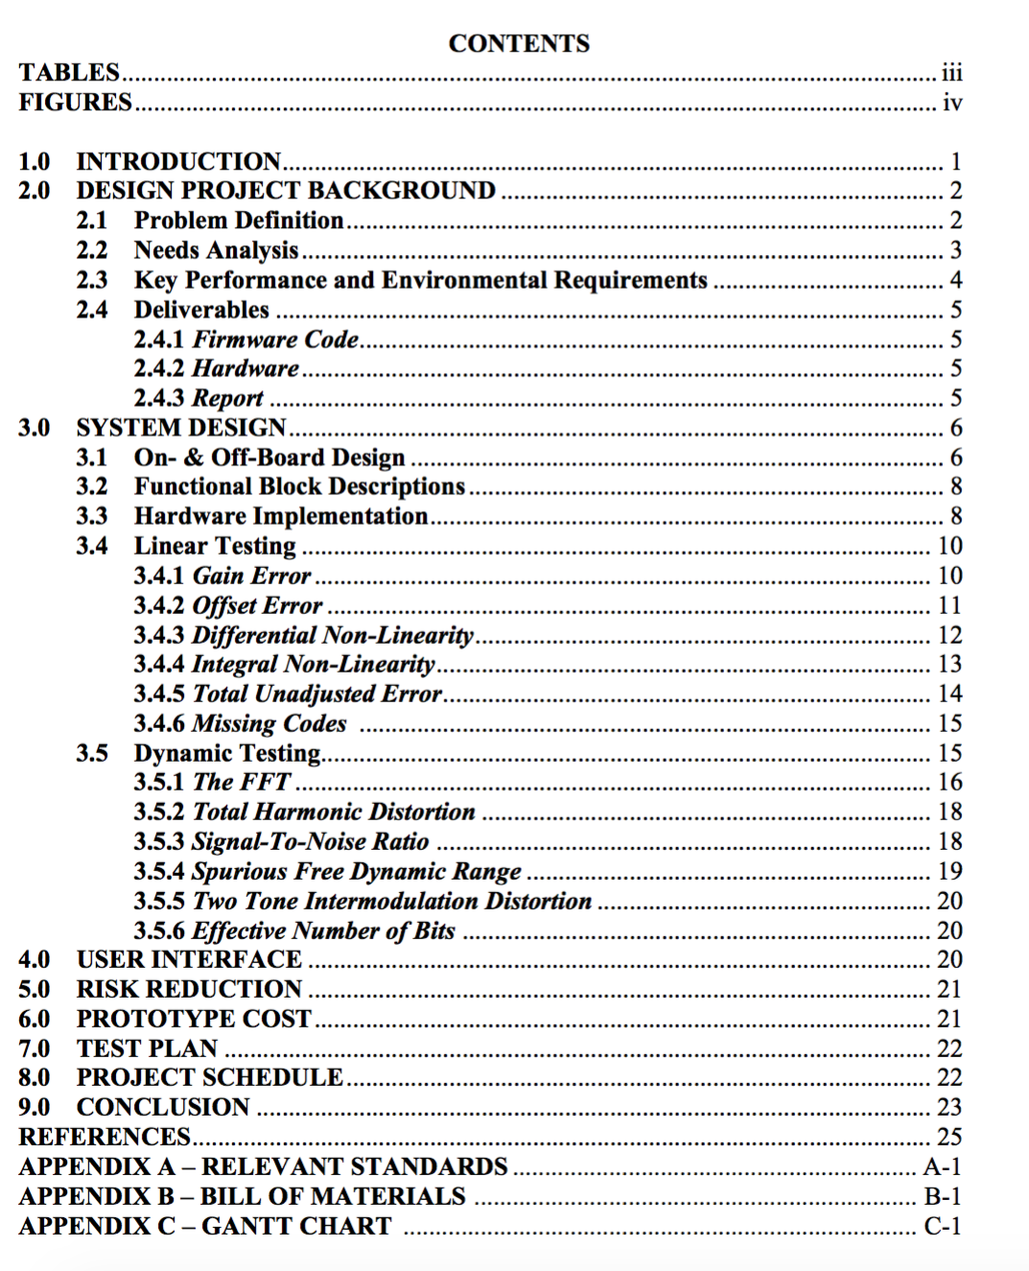
Third Page : Table of Content
Sample

Slide 11
From Fourth Page onwards

Slide 12
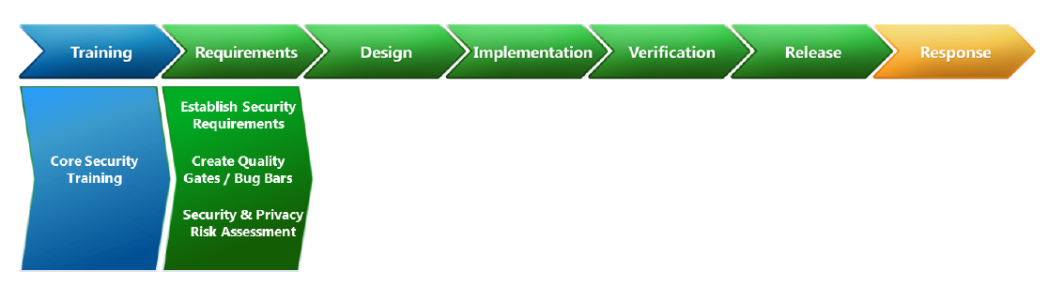
Requirements
The traditional role of requirements engineering is to determine what a system needs to do.
Security is often about getting the software to avoid what it is not supposed to do.

Slide 13
Security Quality Requirements Engineering
Opportunity to consider security at the outset of a project
 Establish Security Requirements
 Project wide requirements – security leads identified, security bug tracking process mandated, architectural requirements set given the planned operational environment
 Create Quality Gates / Bug Bars
 Minimum performance and quality criteria for each stage and for the project as a whole,
 Security and Privacy Risk Assessment
 Risk assessment performed to determine critical components for the purposes of deep security and privacy review

Slide 14
Requirements
Software Requirement Specification
Definition of the Problem and Need for Solution
Modules
Users
Time
Safety Requirement Specification
Programming Language
Data Type
Expressions
Input / Output
Functions
List the recommendations required in your project

Slide 15
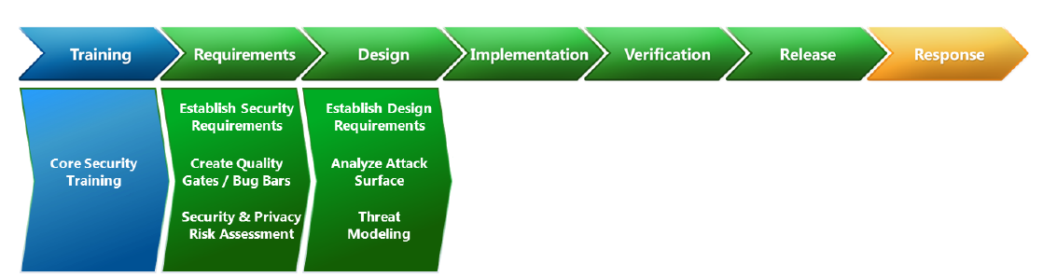
Design
Define and document security architecture, identify security critical
components
Give the pictorial diagram of layout of your project.
Give the Workflow of the application, Make sure security issues are highlighted.
Relate, Justify how you design the application to meet the requirement specified in the previous section
Threat Modeling
 Structured, component-level analysis of the security implications of a proposed design.

Slide 16
Implementation
Add Your Code with file name has heading and highlighted

Slide 17
Testing and Verification
List the test cases
Show the output for correct test cases
Show the output for Legal test cases
Show the out put for illegal or misuse test case

Slide 18
Conclusion
Your Conclusion should be inlined with your abstract and introduction.
Highlight the purpose of recommendations implemented in your application.

Slide 19
Blog
This is for 4 Marks
I wish you create an personal online Blog and upload your experience here
The list of blog sites
https://www.grafdom.com/blog/top-20-best-tech-websites-and-blogs/

Slide 20
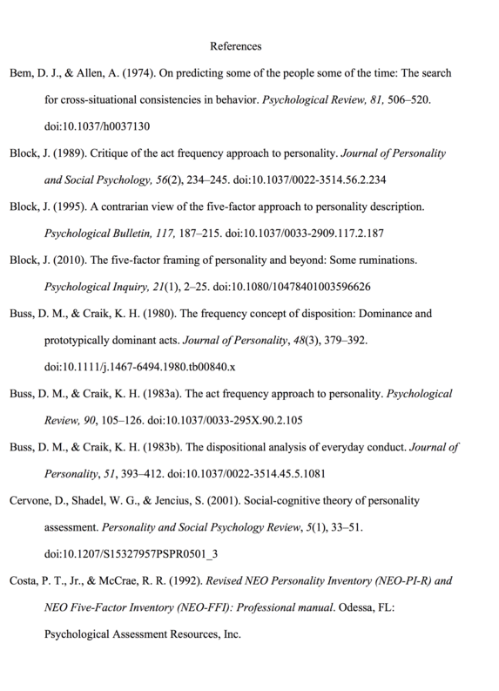
References
Give atleast 5 reference
1: Text book
2: CERT document
3: Any other technical papers
Follow the format

